Slide 1
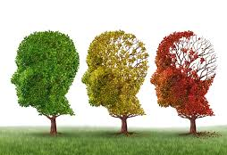
Trajectory of Dementia – End of Life Care
Dr Melissa Abela
University of Tasmania
> utas.edu.au/wicking
Notes:
Acknowledge that there is a range of experiences in the room of working with people with dementia and perhaps people have cared for a family member, partner or friend living with dementia.
We would like to begin the workshop with an overview of dementia and the trajectory that dementia is likely to take throughout the person’s life and introduce to you the concept of end of life care.
We hope after this workshop we can consolidate your knowledge as well as present to you some of the current research around the dementia space and End of Life care as well as providing some useful information about how to communicate with someone living with advanced dementia.

Slide 2
> utas.edu.au/wicking
Notes:
So what is dementia.
Dementia is an umbrella term used to describe a collection of symptoms that are caused by disorders affecting the brain and cognitive impairments.
It progresses to impact on brain function to an extent where it can interfere with the person’s normal social or working life and as a persons dementia progresses, the impacts to physical function, dependence increases, changes in behaviour may be exhibited and overall quality of life can be reduced.
Dementia is a progressive and terminal illness and currently whilst a lot of research is being undertaken in this area, there is no known cure.
It is not one specific disease. There are different types of dementia which can present differently depending upon the region of the brain that is affected.
The most common form of dementia is Alzheimer's Disease, which accounts for 60-80% of dementia cases. Based on this statistic, you are more than likely to care for residents living with Alzheimer’s disease. In fact, an advocate of AD research and famous Australian is Hazel Hawke, pictured here, who was diagnosed with AD and passed away at the age of 83.
You may also have residents here who have been diagnosed with less common forms of dementia in comparison to AD, such as Lewy Body Dementia, vascular dementia and frontotemporal dementia.
Other forms of dementia are Parkinson’s disease as well as Huntington’s disease.
The differences involve different areas of the brain and different structures of the brain. It is important to remember that no one with dementia will behave the same way, because the impacts on the brain are different from person to person. It is important to treat the person as an individual and develop a person-centred care approach to improve their quality of life.

Slide 3
Life Expectancies *
Dementia | Life Expectancy (years*)
Alzheimer's Disease | 4 - 8
Vascular Dementia | 4
Dementia with Lewy Bodies | 2–8
Frontotemporal Dementia | 8
Parkinson's Disease | 9-20
* Variable amongst all cases
> utas.edu.au/wicking
Notes:
Dementia, specifically Alzheimer disease, was the second leading cause of death among people aged 75 and over, behind coronary heart disease.
In fact, since 2006 to 2016 Dementia and AD in females moved from the third leading cause to the first leading cause of death.
Relevance to Tasmania stands out as having the largest population of older people, with over 20% aged 65+ and 8.4% aged 75+.
Research has shown that many people living in RACF’s are living with dementia and do not have a formal diagnosis, which presents a significant challenge for end-of-life care planning.
Health and social care workers, such as yourselves, who provide long term care in RACFs play a key role in end-of-life care decision making for residents and assist their families/loved ones in identifying when the time is right to consider end-of-life care for a person living with dementia. There is a lot of uncertainty regarding the prognosis and identification of people living with dementia which presents a barrier to initiating the discussion about EOL care
Studies indicate that people age 65 and older survive an average of 4 to 8 years after a diagnosis of Alzheimer's dementia, yet some live as long as 20 years with Alzheimer's dementia. This reflects the slow, insidious and uncertain progression of Alzheimer's. A person who lives from age 70 to age 80 with Alzheimer's dementia will spend an average of 40% of this time in the severe stage.
Someone who has DLB can live between 2 – 8 years after a diagnosis but again is variable and can live well beyond this time.
People with a diagnosis of PD have an average of 9 – 20 years post diagnosis. As you can see, there is much variation.

Slide 4
Diagnostic Assessment Tools
Psychogeriatric Assessment Scales Cognitive Impairment Scale (PAS-Cog) - Used as a suite of assessment tools for funding applications in RACFs
Mini Mental Short Examination (MMSE) – the lower the score, the more severe the dementia progression
Montreal Cognitive Assessment (MOCA) –straightforward tool for diagnosis, arranging follow up and treatment plans. Proven to be useful for dementia
Global Deterioration Scale (GDS) – also known as the Reisberg Scale
Functional Assessment Staging Tool (FAST) – very similar to the GDS in that it works in line with the stage
Note all require specialist training to administer and interpret.
Notes:
Improving end‐of‐life care is a top dementia priority. There is increasing interest in how EOL care is provided but most individuals with dementia do not access end-of-life care services. When end-of-life care is used in dementia, it is commonly initiated only in the last weeks of life, possibly because recognizing end of life in dementia can be challenging.
It is hard to know where a person is on their dementia trajectory because many people who enter aged care facilities are older and frailer than ever before, and/or do not have a definitive diagnosis.
There are a number of assessments to assist with knowing where someone is along the illness trajectory.
Cognitive Screening that includes screening assessments to detect cognitive impairment which will trigger more investigations are required.
The following are a few that are in use, but there are many more.
Do you use any of these?
- The Psychogeriatric Assessment Scale which is a cognitive impairment Scale (PAS-Cog) widely used by geriatric assessment teams. It’s a estimate of Cog Status of residents and the amount of support they will require in care homes – helps with funding.
- The MMSE (mini mental) which is widely used. The lower score the more severe the dementia progression.
The Global Deterioration Scale (GDS), developed by Dr. Barry Reisberg, provides caregivers an overview of the stages of cognitive function for people living with Alzheimer's disease.
- The Functional Assessment (FAST) – similar to the GDS and works in line with the stages of one dementia progression.
There can be a delay up to 4 years before symptoms and diagnosis of dementia are arrived at.
In Australia some clinical practice guidelines were released in 2016. Recommendation for agreed and standardised practice for diagnosis and mix of people living with dementia. Download these Guidelines.

Slide 5
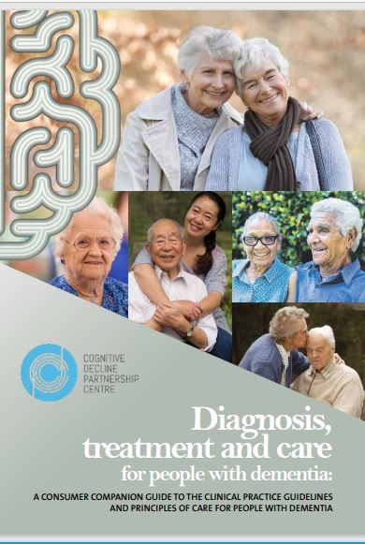
Guidelines
Notes:
The clinical practice guidelines for people with dementia aim to provide health professionals and carers in primary care, aged care and hospital settings with access to recommendations reflecting current evidence on dementia care to better respond to the needs and preferences of the person living with dementia.
The guidelines contain 109 recommendations that health and aged care staff should apply in their workplaces while also responding to the needs and preferences of the person with dementia and their carer(s) and family.
This resource provides practical guidance about important aspects of the clinical practice guidelines for people with dementia.
Download from Dementia Australia

Slide 6
7 Stages of Dementia – Global Deterioration Scale (GDS)
 | MEMORY LOSS | FUNCTIONAL LOSS
Stage 1 | No subjective complaints of memory loss | Normal function
Stage 2 | Very mild decline | Person may feel as tough they are having memory lapses but these are invisible to family and friends
Stage 3 | Mild decline | Trouble remembering names and performing some complex activities. May lose or misplace valuable possessions
Stage 4 | Moderate decline | Greater difficulty with performing complex tasks such as instrumental activities of daily living (managing finances, shopping). May be becoming moody or withdrawn
Stage 5 | Moderately Severe decline | May still be independent with eating and toileting. May forget own address. May require assistance with choosing weather-appropriate clothing
Stage 6 | Severe decline | Personality changes may take place. May need assistance with activities of daily living. Experiences disturbed sleep, May wander and become lost.
Stage 7 | Very Severe decline | Likely need assistance with all aspects of care. May or may not retain verbal abilities. Muscles may become rigid, swallowing may be impaired.
> utas.edu.au/wicking
Notes:
Let us now identify the last three stages of dementia according to the Global deterioration scale – the 7 stages of dementia.

Slide 7
7 Stages of Dementia – Global Deterioration Scale (GDS)
> utas.edu.au/wicking
Notes:
The GDS is broken down into 7 different stages. Can use your browser to view the Youtube video
Stages of dementia and Alzheimer's disease | Mental health | NCLEX-RN | Khan Academy - YouTube
Stages 1-3 are the pre-dementia stages.

Slide 8
Advanced Dementia (Stage 7)
Severe + end stages of dementia
Progressive immobility
Reduced capacity to self care
Poor nutrition which results in reduced fluid intake
Increased risk of infections
Skin Breakdown
Notes:
In research conducted by the Wicking Dementia Education and Research Centre’s Massive Online Course (the MOOC), the value of planning ahead for end of life was raised by participants. This was within the broad context of the meaning of
palliative care and participants identified that it was important to:
Recognise and introduce a plan for palliation before the imminent arrival of the point of death. The bravery to discuss this early in the disease process while the person with dementia can contribute to the plan for their future journey.

Slide 9
“Recognising and introducing the plan for palliation before the imminent arrival of the point of death. The bravery to discuss this early in the disease process while the person with dementia can contribute to the plan for their future journey” (MOOC Participant)
Notes:
A palliative approach can give the most appropriate type of care for people with dementia at any stage of their illness. It should definitely be a focus of care by the time the person with dementia reaches the advanced stages of their dementia.
As we have noted, the person living with advanced dementia may be unable to recognise people or objects, have difficulty communicating, chair or bed bound, require assistance with ADL’s such as dressing and washing and feeding themselves. They may experience pain, sleep disturbances, incontinence, confusion and depression.
At this point, a palliative approach would be of utmost benefit.
Another challenge is Why is talking about death and dying with families of people living with dementia important
In research conducted by MOOC participants at the Dementia research and education centre the value of planning ahead for later life needs was raised by participants within the broad context of the meaning of
palliative care by identifying that it was important to Recognising and introducing the plan for palliation before the imminent arrival of the point of death. The bravery to discuss this early in the disease process while the person with dementia can contribute to the plan for their future journey

Slide 10
A Palliative Approach to Dementia Care
Overall quality of life
Early recognition of pain and treatment for pain
Affirming life and treating dying as a natural process
Offering a support system to help the family cope during their loved one’s illness
In dementia the end stages is not often identified.
Notes:
A palliative approach to care means that you can focus on these aspects – see slides

Slide 11
Challenges for Managing Advanced Dementia
Lack of understanding about the terminal nature of dementia​
Hospitalisations, benefits and burdens of treatment vs a palliative approach ? Quality of life, delivering person-centered care​
Lack of awareness of end of life care options: ​- manage, kept comfortable in facility
Difficulty in recognising the terminal phase
Role of specialist palliative care​- services (CNS) guide decision, not all facilities have this level of services
Importance of communication with family and others​
Early advance care planning ​
Notes:
We know that these can be challenging

Slide 12
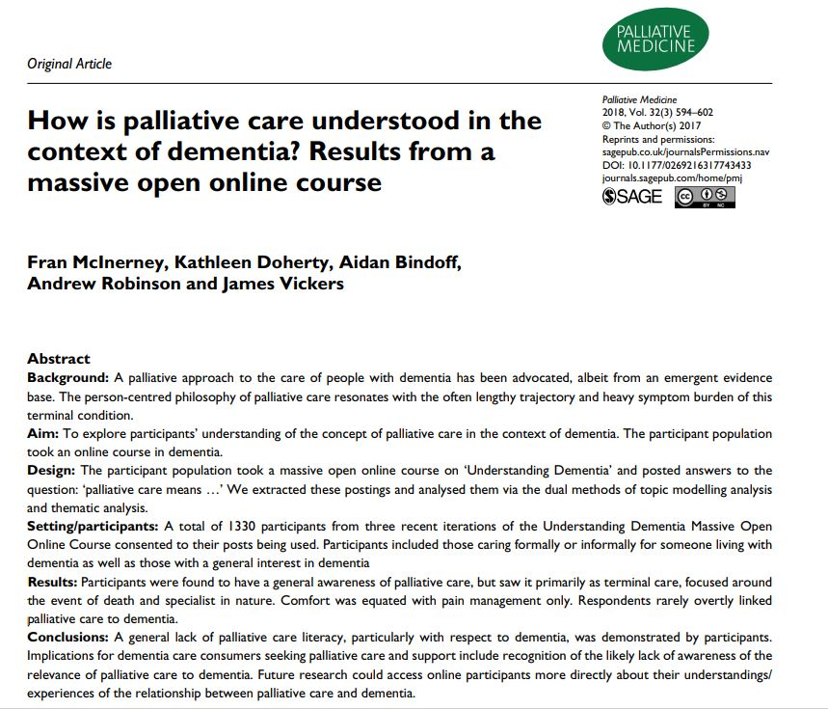
Caring holistically to offer a support system for all
Multidisciplinary approach
Generalised awareness – reported as terminal care
Comfort = pain management
Not typically related to dementia care
Not sure how to provide EOL care for someone living with dementia
Notes:
McInerney et al. study on “How is palliative care understood in the context of dementia?”
The aim was to explore participants’ understanding of the concept of palliative care in the context of dementia. The participant population took an online course in dementia (The MOOC).
Participants were found to have a general awareness of palliative care, but saw it primarily as terminal care, focused around the event of death and specialist in nature.
Comfort was equated with pain management only.
Respondents rarely linked palliative care to dementia.
Overall, participants were unsure how to provide EOL care for someone living with dementia.

Slide 13
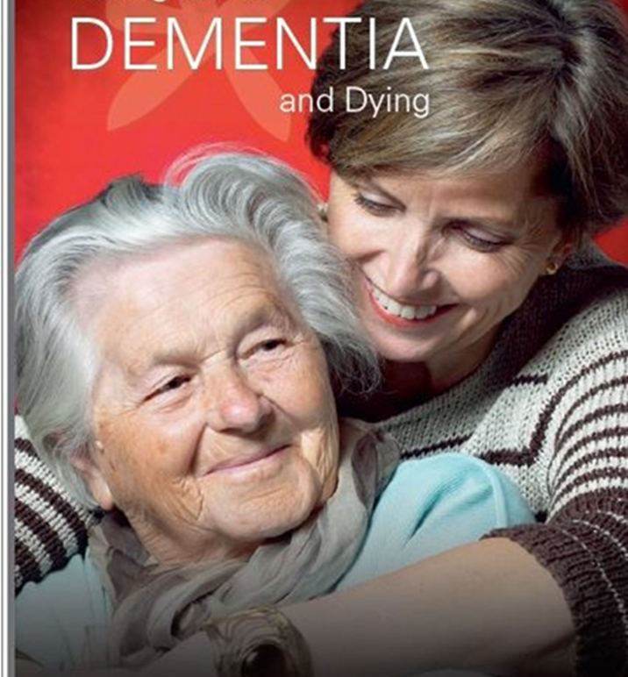
Talking about Dementia and End of Life Care
Dementia is a terminal illness with NO CURE
Gradual decline with more acute illnesses
Focus:
- Overall QoL
- Early recognition and treatment of pain/distress
- Affirming life and treating dying as a normal process
Notes:
This useful booklet on dementia and dying was developed by staff at the wicking centre and the School of Nursing in 2001. It is currently flagged for updating but the information is still reliable and it can be downloaded for use.
It is a discussion resource to help people working in facilities to openly communicate with people with dementia and their families and friends about death and dying. Talking about dying is often difficult and this tool provides guidance for those who would like to improve their skills.

Slide 14
Formal vs Informal Approach
FORMAL
Prepare
Introduce
Ask (Person centred approach)
Flag the seriousness
Inform about dementia and dying
Allowing space
Discuss Care
Ongoing Dialogue
Self Care - debrief
INFORMAL
Concern for your resident
Spontaneous but tactful approach
Notes:
Dementia care and communication – booklet developed by staff at the wicking and nursing. Undergoing review but you can download it.
PREPARE for the discussion. Ensure you have the correct environment, enough time, meeting with the correct people (family and staff). You could start the conversation by saying “as part of our normal care planning we would like to invite you and family members to meet to discuss condition and care.
INTRODUCE yourself and everyone present. Ask those present if they have any questions and to write anything down during the meeting to address later
ASK about the person living with dementia. Person Centred Care
FLAG dementia In case family are unaware that they have dementia and this is life limiting.
INFORM about dementia, implications for cognitive and functional decline. Use plain language, simple explanations, disease of the brain, trajectory and no certainty about the length of time.
ALLOW space for emotions. Use of reflective language may help the family give a name to emotions that they are feeling
DISCUSS a second meeting depending on how the family are taking the news. Discuss the care needs and focus of care by linking the family's story, discuss goals of care, document goals of care, focus on care goals such as keeping person with dementia comfortable, happy, engaged. Discuss later life goals of care, end of care directives, hospital admissions, feeding tubes etc.
ONGOING dialogue – discuss questions family may have
SELF CARE – acknowledge your own emotions as soon as possible. Integrate this into the end of the meeting when family members have left.

Slide 15
Case Study
87 year old man with Alzheimer’s Disease​
Diagnosed with hypertension, Osteoporosis, OA, deafness, hernia repair​
Living in RACF for 2+ years​
Psychogeriatric Assessment Scales (PAS) Cognitive Impairment Scale and Functional Assessment Staging Test (FAST) completed to indicate dementia in stage 5-7
Six months of slow functional decline reported​
Admission to hospital with SOB, vomiting – diagnosis of pneumonia​
Notes:
Let’s look at a case study. This case study was based on real life events that you may be able to relate with residents in this facility or a facility that you have previously worked at.
This 87-year-old man has been living in a residential aged care facility for more than 2 years now. He has AD as well as hypertension, Osteoporosis, OA, deafness and had a hernia repair. When he was admitted to the residential aged care he was functioning quite well and this was demonstrated by a PAS cognitive impairment scores and FAST assessment tool.
Over the past six months he has slowly declined in his functional capacity.
He has been admitted to hospital with shortness of breath, vomiting and had a diagnosis of dementia.

Slide 16
To hospitalise or not to hospitalise
Is this an appropriate admission?​
What else can be done?​
What could have helped with this decision?​
What are the risks of hospitalisation?​
Notes:
So the question that I want to ask you is whether this gentleman should have been hospitalised or not?. Is this an appropriate admission? What else could have been done? What could have helped with the decision?
Think about these questions whilst we consider the risks of hospitalisation particularly for someone living with dementia.

Slide 17
Risk Associated with Hospitalisation
Reduced tolerance to hospital setting – due to changes to the brain
Stressors such as fatigue, acute illness, pain, change in routing, or confusing stimuli – noise, lights, can trigger occurrence of behaviours (?)
Behaviours become way of communication
Aggressive behaviours may lead to chemical and physical restraints​
Longer LOS, pressure areas, infection, poor oral intake, apathy and withdrawal, higher delirium rates​
Notes:
Risks: trigger for BPSDs, higher rates of delirium, longer LOS, higher use chemical and physical restraints, pressure sores, higher UTI, pneumonia rates once hospitalised, (more likely to be readmitted in 3 months and more frequent hospital stays (Draper et al. Hospital Dementia Services Project)
Responsive behaviours – the term BPSD (behavioural and psychological symptoms of dementia) is also used in the literature. Important to the person with dementia, responsive behaviours are generally in response of an unmet need.
Physical restraints – strict scrutiny using these physical restraints particularly lately with the Royal Commission in Aged Care Quality and Safety. Has impacts for staff

Slide 18
On-going symptom management and support​
Daughter: very unsettled in hospital, bed rail use​
Return to facility: initially alert and happy, non-ambulant, decreased diet, minimal oral intake, restless, resistive to care, anxious, evidence of pain​
Restraint authority signed​
Bedbound: lifter x4, trolley bath​
Notes:
Risks: trigger for BPSDs, higher rates of delirium, longer LOS, higher use chemical and physical restraints, pressure sores, higher risk of UTIs, pneumonia rates once hospitalised, (more likely to be readmitted in 3 months and more frequent hospital stays (Draper et al. Hospital Dementia Services Project)

Slide 19
Goals of Care – Comfort Care
Limit interventions causing stress which led to comfort care​
Offer food and fluids as tolerated (comfort feeding)​
Deterioration and agitation over days; pain score of 7-8 (Abbey)​
Distress at nursing care (grimacing); pooling food and fluids​
Died 2 weeks post discharge
Notes:
A palliative approach was adopted for this man two weeks prior to dying. What effects did hospitalisation have on his quality of life?

Slide 20
Reflective Questions
Three key words/phrases that you think describes a palliative care approach.
Discuss common signs and responsive behaviours of advanced dementia.
Discuss main ways discomfort and pain are currently managed.
What is your vision, goal, aim when a resident is dying.
Notes:
A palliative approach was adopted for this man two weeks prior to dying. What could have been done differently?

